Slide 1
Presented by
Wengie Wang, Yuhan Xie, Hengjiali Xu

Slide 2

Introducing
M
A
athematic udio Expression
alculator
C

Slide 3
Introducing
M
A
athematic udio Expression
alculator
C
Notes:
Goal: Use machine learning algorithms to take math expressions in the form of user speeches, produce the equations in digital mathematical expressions and compute the results

Slide 4

You’ve never seen a calculator like this.
Kids’ ultimate math tutor
Notes:
Our motivation for this project is to create an audio calculator that can be useful for various groups of people. Specifically
Students: educate younger children who may not be familiar with calculators; turn math study into a more interesting process.

Slide 5
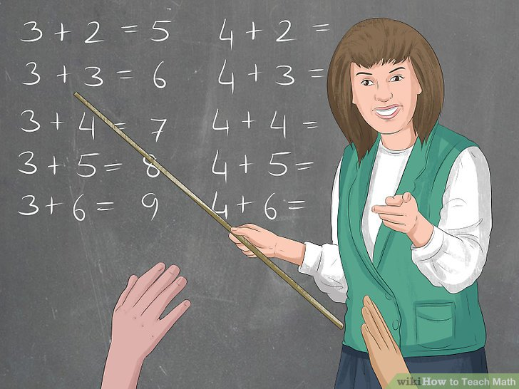
You’ve never seen a calculator like this.
Math teachers’ best assistant
Notes:
Teachers: we want to create an audio calculator that can make math education easier and more effective

Slide 6
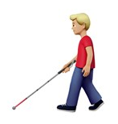
You’ve never seen a calculator like this.
The disabled’s ideal learning support
Notes:
Most importantly, this audio calculator will benefit the physically disabled people to do math calculations in a more convenient way

Slide 7
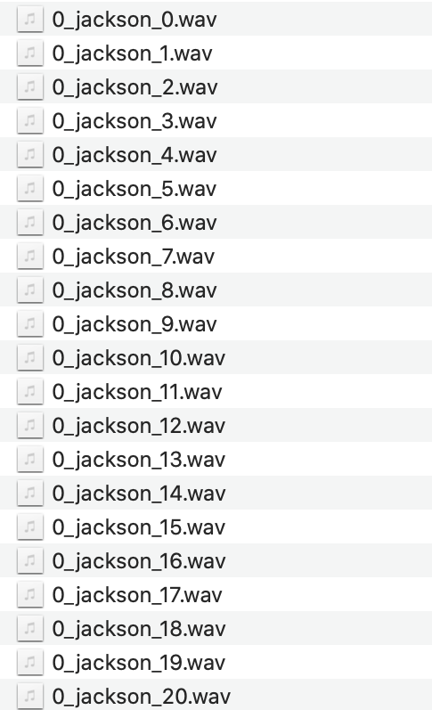
What’s inside MAC?
Dataset
Free Spoken Digit Dataset (FSDD)
4 speakers
0 - 9 digits, each is recorded 50 times/person
.wav files, 8000 kHz
2,000 recordings
Notes:
We collected online Free Spoken Digit Dataset. The dataset contains recordings of ten digits from 0 to 9. Each digit is recorded 50 times by four speakers. There are 2000 recordings of digits in total.

Slide 8
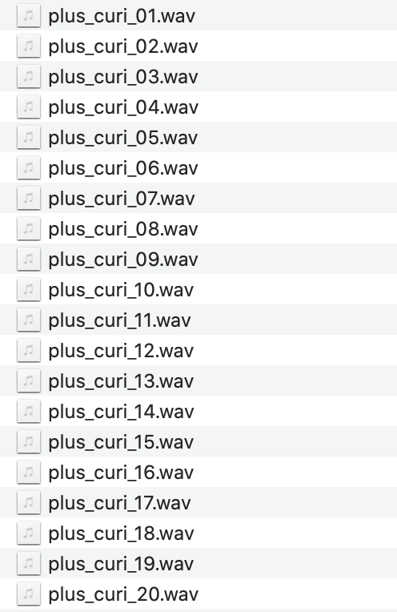
What’s inside MAC?
Dataset
Manually record addition, subtraction, multiplication and division
3 speakers (Wengie, Yuhan, Hengjiali)
“plus”, “minus”, “times”, “over”, each one is recorded 50 times/person
.wav files, 8000 kHz
600 recordings
Notes:
We also manually recorded four basic mathematical operators, which are addition, subtraction, multiplication and division. Each of the group members recorded “plus”, “minus”, “times”, “over” 50 times respectively. There are 600 recordings of operators in total.

Slide 9
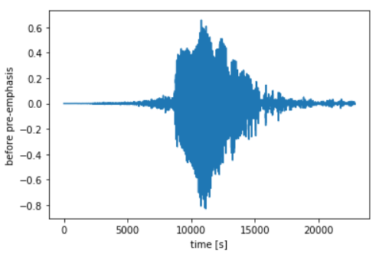
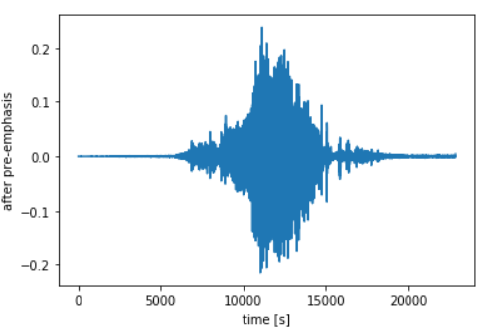
What’s inside MAC?
Data Cleaning & Preprocessing
Pre-emphasis
amplify
reduce noise
Notes:
After we get the raw audio inputs, we first performed pre-emphasis on the audio inputs. Specifically, we boosted the signal’s high-frequency components and reduced the noises.

Slide 10
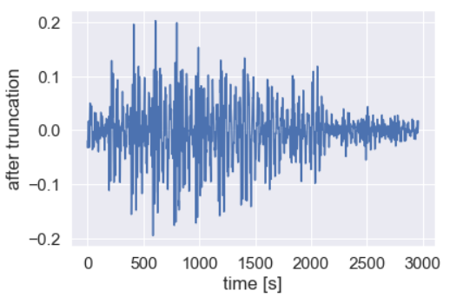
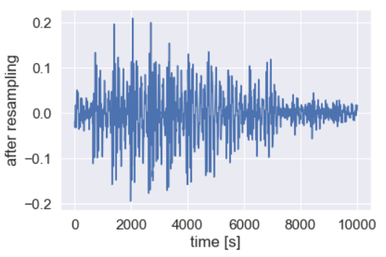
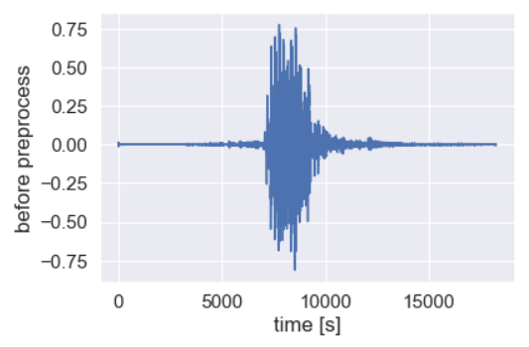
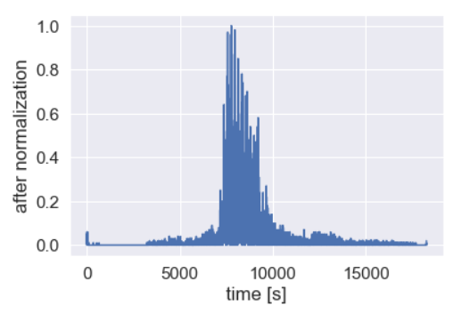
What’s inside MAC?
Data Cleaning & Preprocessing
Normalize absolute value of amplitude
Cut start, stop points
Resample
Notes:
After pre-emphasis, we then normalized the amplitude in order to find the starting and ending points. Afterwards, we cut off the beginning and the ending part using the threshold of 0.1. Then, we stretch all the sample audio clips to 10,000 frames

Slide 11
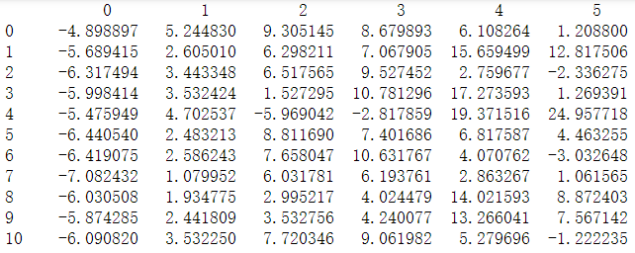
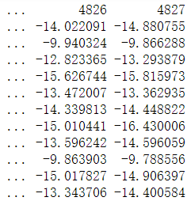
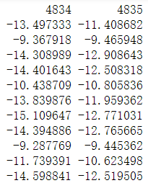
What’s inside MAC?
PCA?
☹️Nuh-uh
Feature Extraction
Mel-frequency cepstral coefficients (MFCC)
Frequency log bank feature
MFCC
Frequency log bank
Notes:
These two kinds of features are common for audio recognition. We concatenated them and built the design matrix.

Slide 12
What’s inside MAC?
Models
Logistic Regression
Random Forests
RBF Kernel Support Vector Machine (SVM)

Slide 13
What’s inside MAC?
Models
Logistic Regression
Linear model
Test accuracy:
Digits: 82.17%
Operators: 92.86%
Applying Adaboost algorithm:
Test accuracy:
Digits: 83.3%
Operators: 93.6%
Random Forests
RBF Kernel Support Vector Machine (SVM)
Notes:
We decided to train the digits and operators separately because if you say an operation it goes in the order of digit operator and digit again. If we train them separately, the accuracy would be higher than if we train them together.

Slide 14
What’s inside MAC?
Models
Logistic Regression
Test accuracy:
Digits: 90.5%
Operators: 94.87%
Applying Adaboost algorithm:
Test accuracy:
Digits: 89.5%
Operators: 94.9%
Random Forests
RBF Kernel Support Vector Machine (SVM)

Slide 15
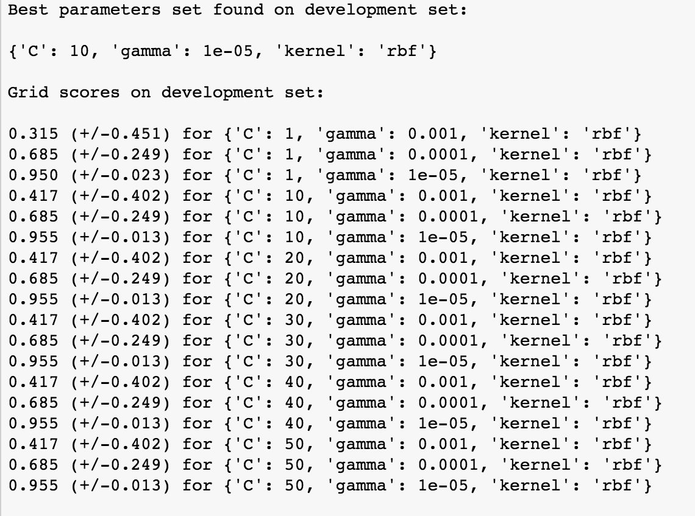
What’s inside MAC?
Models
Logistic Regression
Non-linear model
Hyper-parameters: C & Gamma
C = 10, gamma = 0.00005
Test accuracy:
Digits: 93.6%
Operators: 93.9%
Random Forests
RBF Kernel Support Vector Machine (SVM)

Slide 16
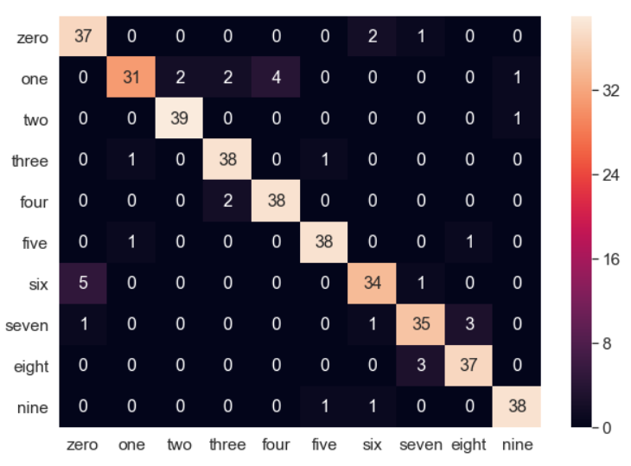
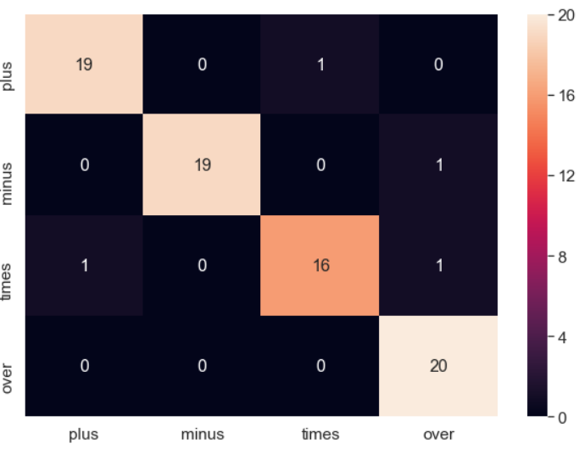
Compare MAC models
Model | Digit Test Accuracy | Operator Test Accuracy
Logistic Regression | 82.17% | 92.86%
Adaboost-LR | 83.3% | 93.6%
Random Forests | 90.5% | 94.87%
Adaboost-RF | 89.5% | 94.9%
RBF Kernel SVM | 93.6% | 93.6%
Majority vote

Slide 17
Limitations
Small sample size
Small variation
4 speakers for digis
3 speakers for operators
Overfitting
Training accuracy: 100%

Slide 18
Next steps
Increase sample size
Increase variation
Involve more speakers
Use more ML methods
Neural networks
XGBoost

Slide 19
Demo

Slide 20
Thank you for listening

Slide 21
Q & A

